Slide 1
Huffman Compression
Presentation: Monday 10:40am
Group 4 - Thursday 11:30
Yuqin Sophia Duan, Alan Han
GTA: Chuan-Yean Tan

Slide 2
Overview
Usage: Lossless data compression
Applications: Text transmission, cryptography, graphical processing, etc.
Tools
AHB Bus
Huffman Encoding Module
ASIC requirements
High speed
Clock cycle < 10ns
Accuracy (lossless)

Slide 3
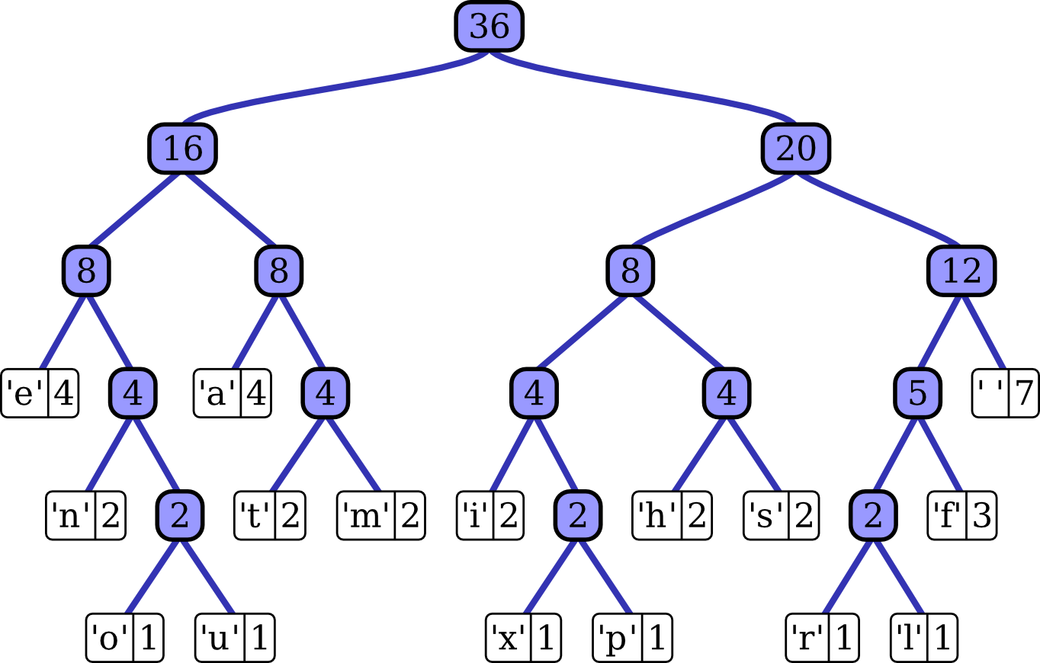
Overview - Compression Process
Determine frequency of each character
Construct a tree
Leaves: each char frequency
Internal: sum of children
More frequent leaves are closer to root

Slide 4
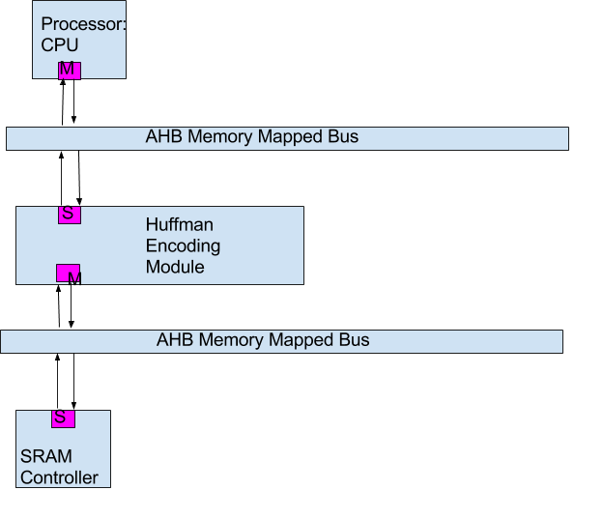
System Usage

Slide 5
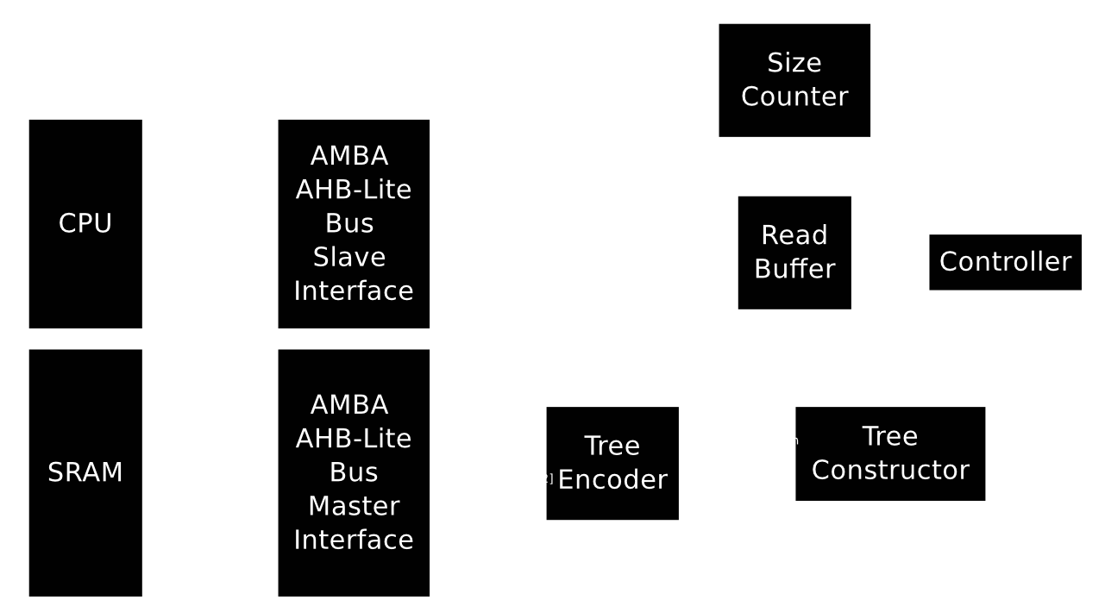
System Diagram

Slide 6
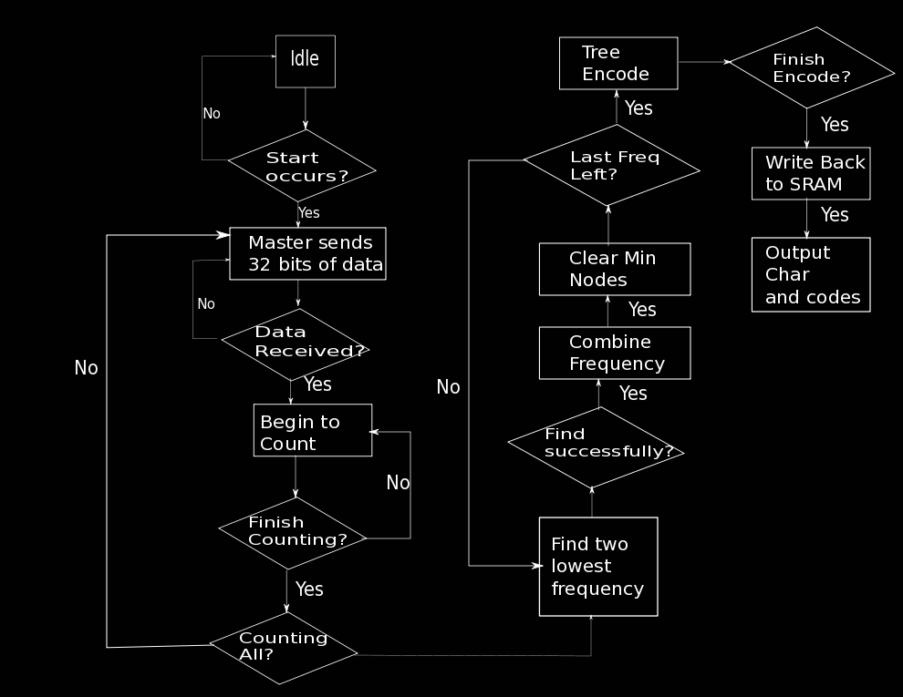
Operational Characteristics

Slide 7
Operational Characteristics
Common sequences of operation
AHB Single Read/Write
Biggest Decisions
AHB 32-bit bus width
Tree construction algorithm

Slide 8
Results - Design Specific Success Criteria
(2 points) Demonstrate by simulation of Verilog test benches that the complete design is able to correctly encode a message (fully operational).
(2 points) Demonstrate by simulation of building an encode tree.
(2 points) Demonstrate by simulation of Verilog test benches that the AHB bus is able to read and write from SRAM.
(2 points) Demonstrate by simulation of Verilog test benches that the read buffer module can correctly count frequencies.
Notes:
Success status slide

Slide 9
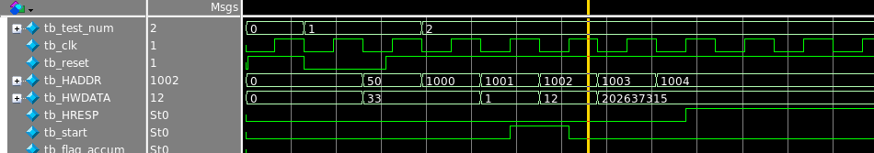
Demonstration of AHB Read
Addr1
Addr2
Addr3
Data1
Data2
Data3

Slide 10
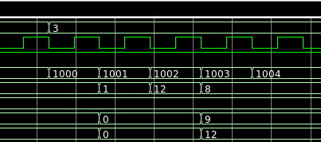
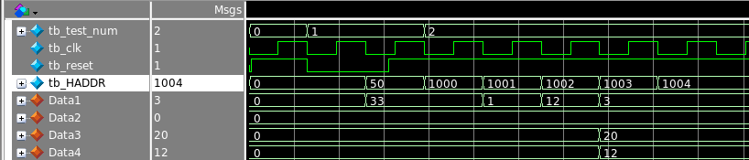
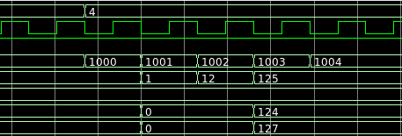
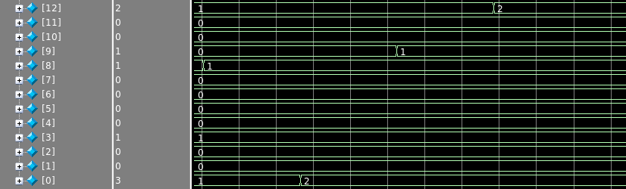
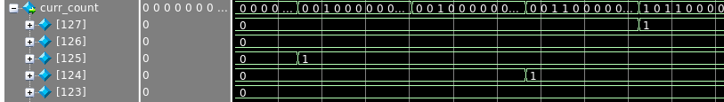
Read Buffer counts correctly

Slide 11
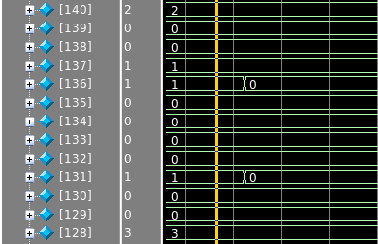
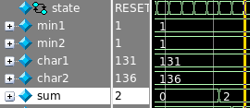

Demonstration tree construct
If min selected
clear
Indiv
freq
Right addr
One Node
Left addr
Sum Freq

Slide 12
Demonstration: Tree Encode
Input: A 7 B 3 C 2 D 6 E 4 F 10
11
1011
1010
100
01
00

Slide 13
Fixed Criteria - Results
Actual Area: 32.87 mm^2
Estimated Area: 25 mm^2
Huffman Read: 6 mm^2
Huffman Tree: 26 mm^2
Estimation Tree area if using SRAM: 13 mm^2 (8500 registers less)
Clock Rate: 10 ns
Critical Path: 8.22 ns

Slide 14
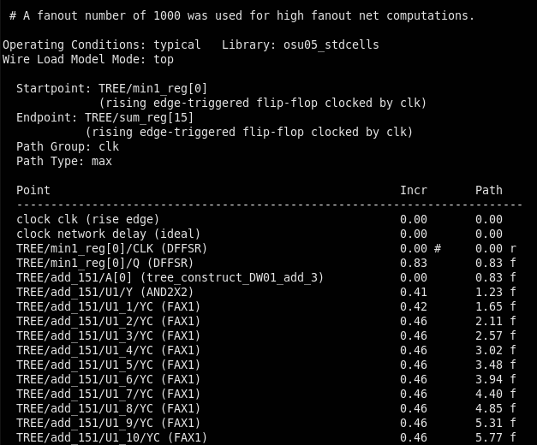
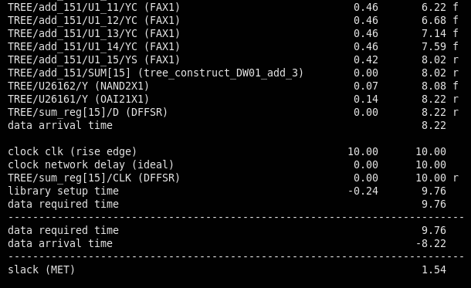
Fixed Criteria Results - Critical Path

Slide 15
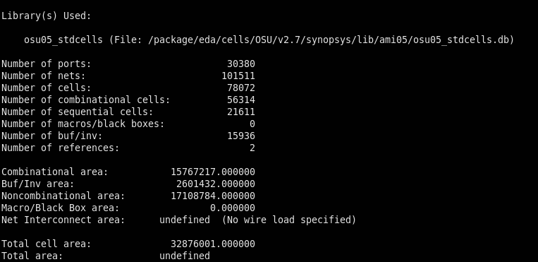
Fixed Criteria Results - Area
32.87/25 = 1.31

Slide 16
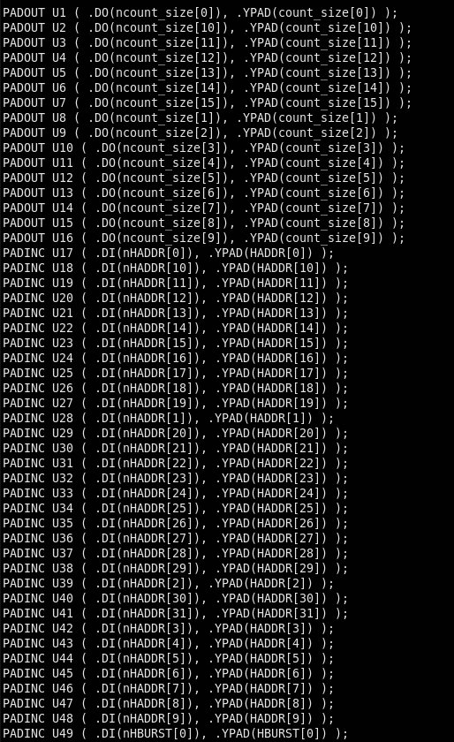
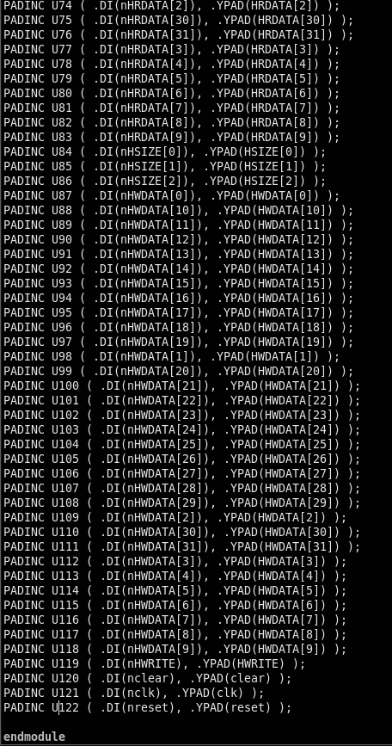
Results - Layout
Pads: 122

Slide 17
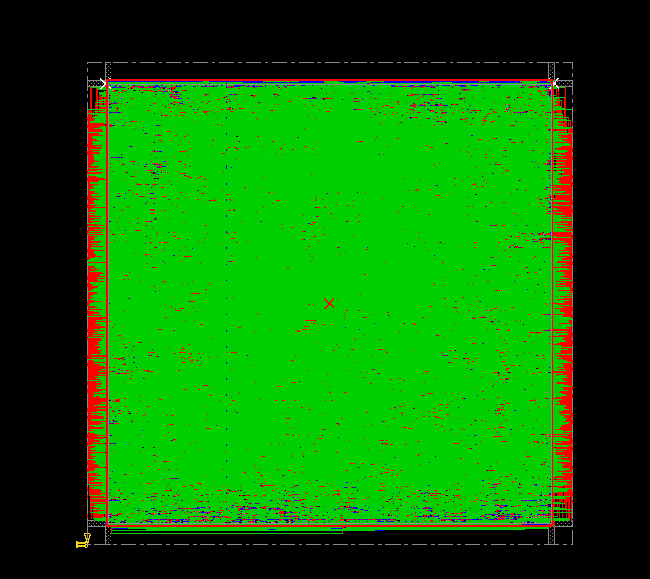
Layout

Slide 18
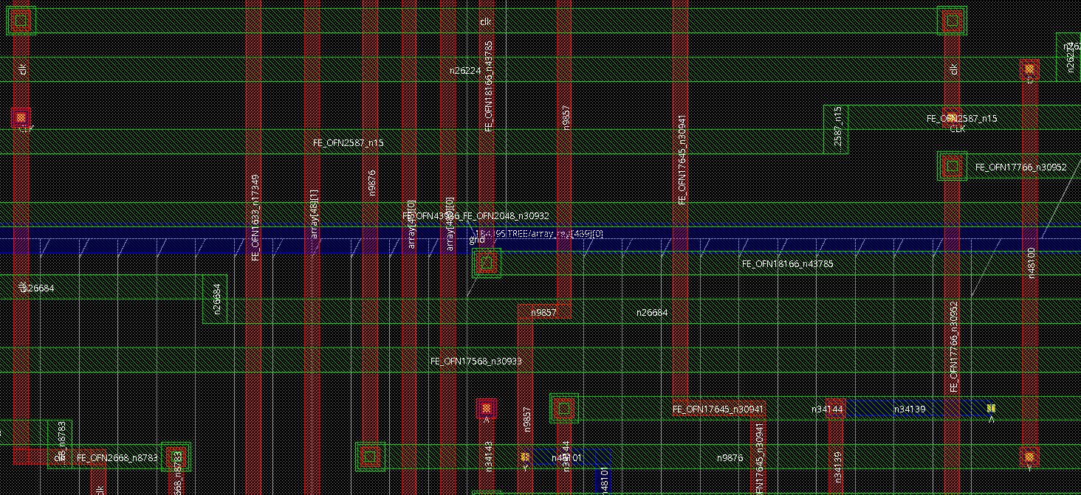
Layout-Zoom
Encode Array

Slide 19
Conclusions
Challenges
Tree construction at the hardware level
Keeping information intact between different modules
Timing and area optimization
Improvements
Implement working AHB/SRAM interface
Implement parallelized Read Buffer

Slide 20
Questions?

Slide 21
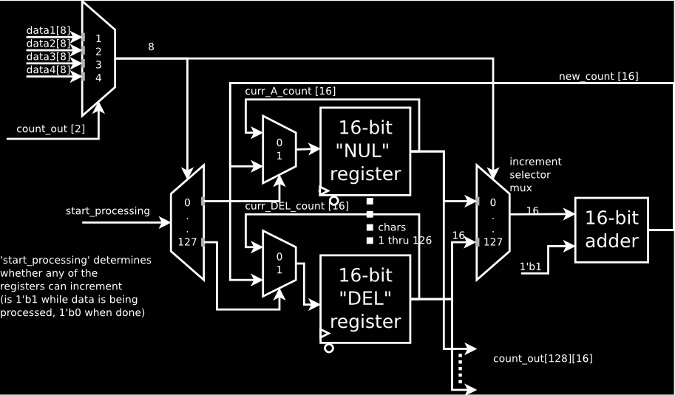
Read Buffer RTL

Slide 22
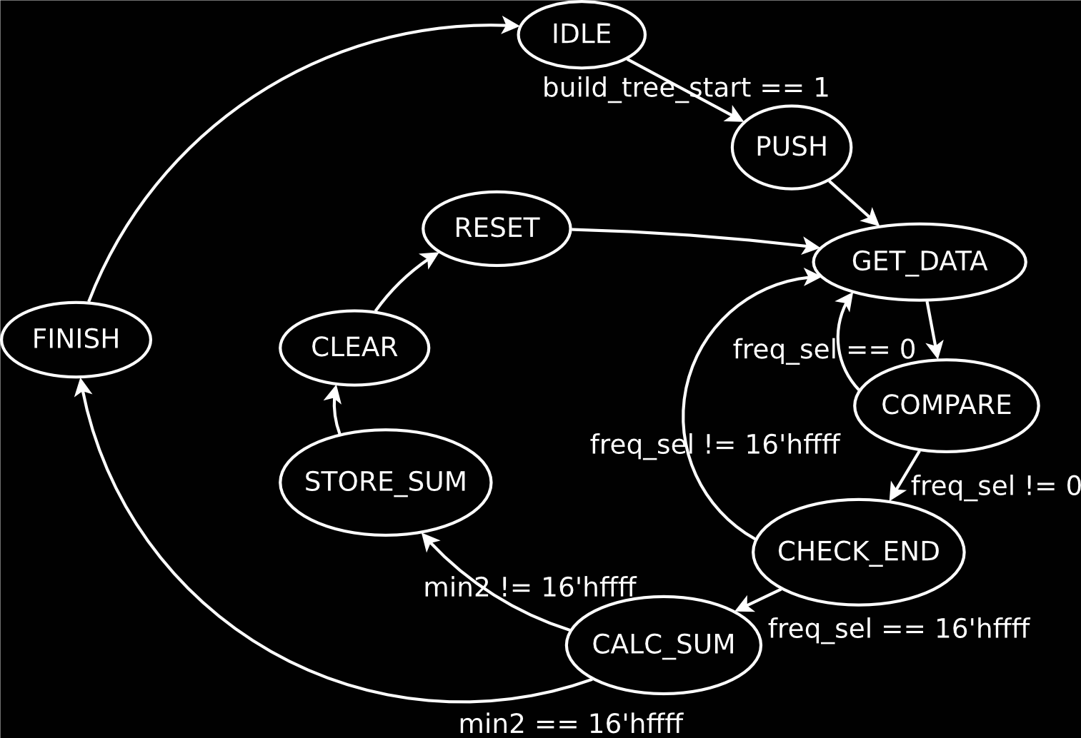
Tree Constructor STD

Slide 23
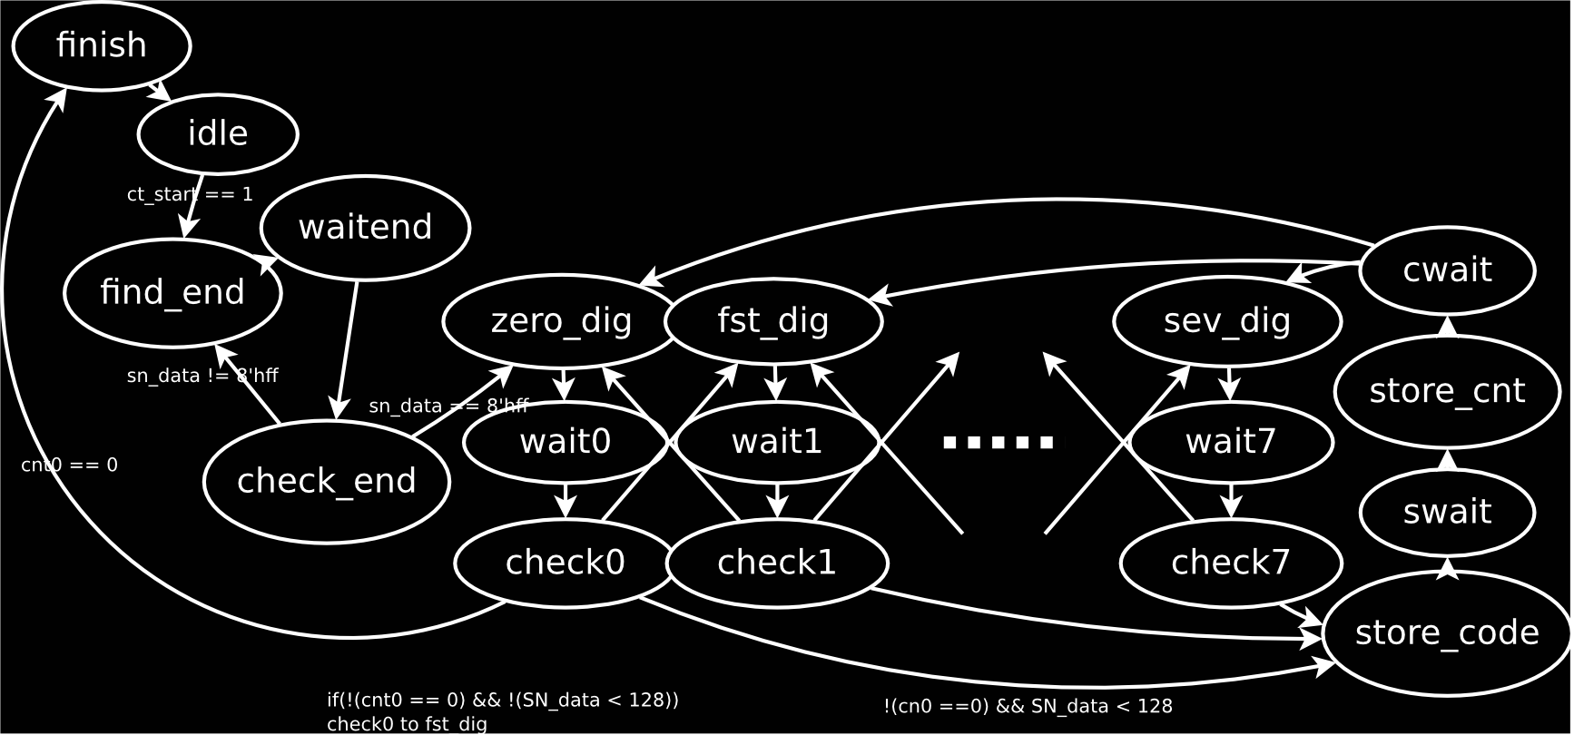
Tree Encoder STD

